Slide 1


Greener Pastures
Kevin Sheekey
Kyle Pavelka
Matthew Brown
Meriane Franco
Ravi Patel
03/20/2021

Slide 2

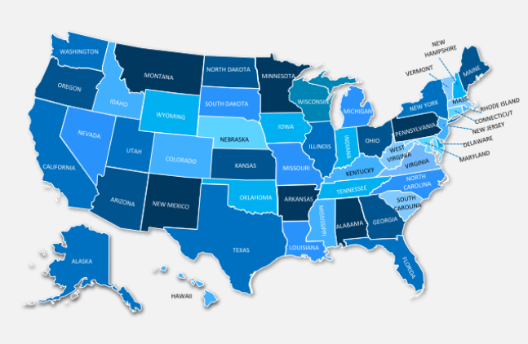



Motivation
Is there a better place to go now?
No matter the current condition people have,
there is always a search for BETTER.

Slide 3

What does BETTER mean?
Economics
Job opportunities
Safety
Health system
Fun & Entertainment
Cost of living
Maslow's Pyramid of Human Needs

Slide 4
Data needed
Economics
Business opening vs closure
Job opportunities
Availability & salaries
Safety
Less crimes incidence
Health system
Availability
Fun & Entertainment
Public & Pet Spaces
Cost of living
Housing cost

Slide 5
Data Source
Crime incidence
https://crime-data-explorer.fr.cloud.gov/api
Economics -Business opening vs closure
EconomicTracker/oi_tracker_data_dictionary.md at main · OpportunityInsights/EconomicTracker · GitHub
Job Availability & salaries
https://www.bls.gov/data/#unemployment
Housing cost
https://www.bestplaces.net/housing/zip-code/new_jersey/edison/08820
Public & Pet Spaces
Health system availability

Slide 6
BLS Modeled Wage Estimate (MWE): Expected $/hr
Modeled Wage Estimate Background
(https://www.bls.gov/mwe/)
Key Concepts Employed
Encoded Series Names where search parameters for the specific MWE are contained within the index name.
Obtaining Data from a Web Page not API, not csv.
Dynamic Variable Name creation using dictionaries to for use in decoding.
Augmenting Results using wider search parameters whenever a value could not be found (even if the augmented value is just “Not Found”)
Providing a .csv Output for other team members to use. That int
Provide annual estimates of average hourly wages for occupations by selected job characteristics and within geographical location.
Produced using a statistical procedure that combines survey data collected by the National Compensation Survey (NCS) and the Occupational Employment Statistics (OES) programs.
Most recent data is from 2019, but plenty of data and provides a good challenge for data cleanup methods.
GOAL: Decode the BLS series to provide a table of MWE values for a trimmed list of 21 occupation types for every city in the GEO dataset. Merge it with the main GEO city dataset by matching BLS region names to GEO city names.

Slide 7
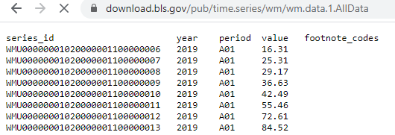
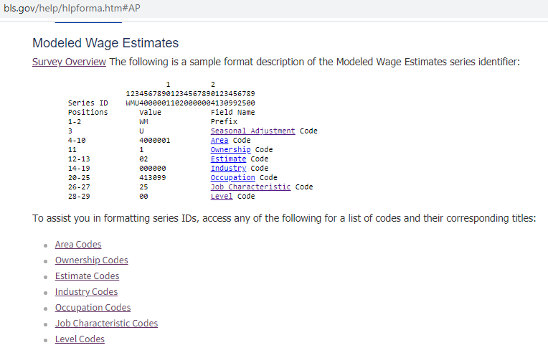
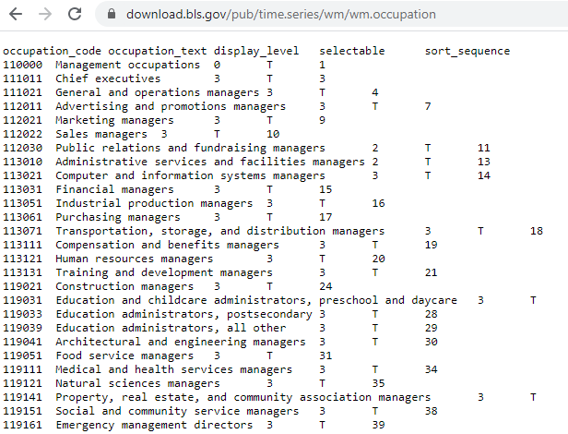
Encoded Series Names
KEY TAKE AWAYS
Data
Substrings at certain positions inform what the series represents.
Documentation exists to help translate.
Can the process of retrieving data and translating using provided dictionaries be integrated/automated? YES!
Translation
Guide
Dictionary Data

Slide 8
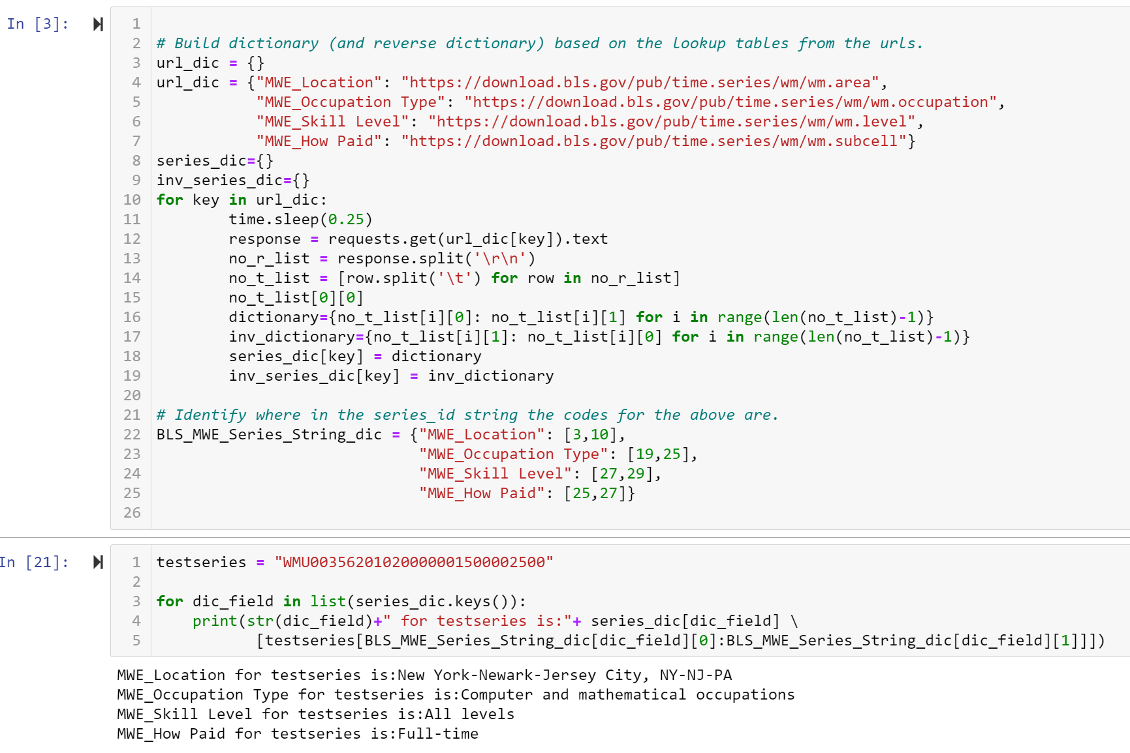
Encoded Series Names → Obtaining Data from Webpage
→ Dynamic Variable Name/Dictionaries
KEY TAKE AWAYS
Able to request from the URLs.
Custom code writes the data to dictionaries, for each URL.
dic_field chooses which dictionary is getting looked at.
Based on which dictionary in dic_field, the for loop knows which substring to extract.
The substring is fed to the dictionary as a key for a corresponding value.
To summarize, series_dic[dic_field][series_subtring] can lookup the piece of the series name in the corresponding dictionary that contains it!
Note:
This region code combines two or more series which may pose a problem for unique row creation. (next slide)

Slide 9
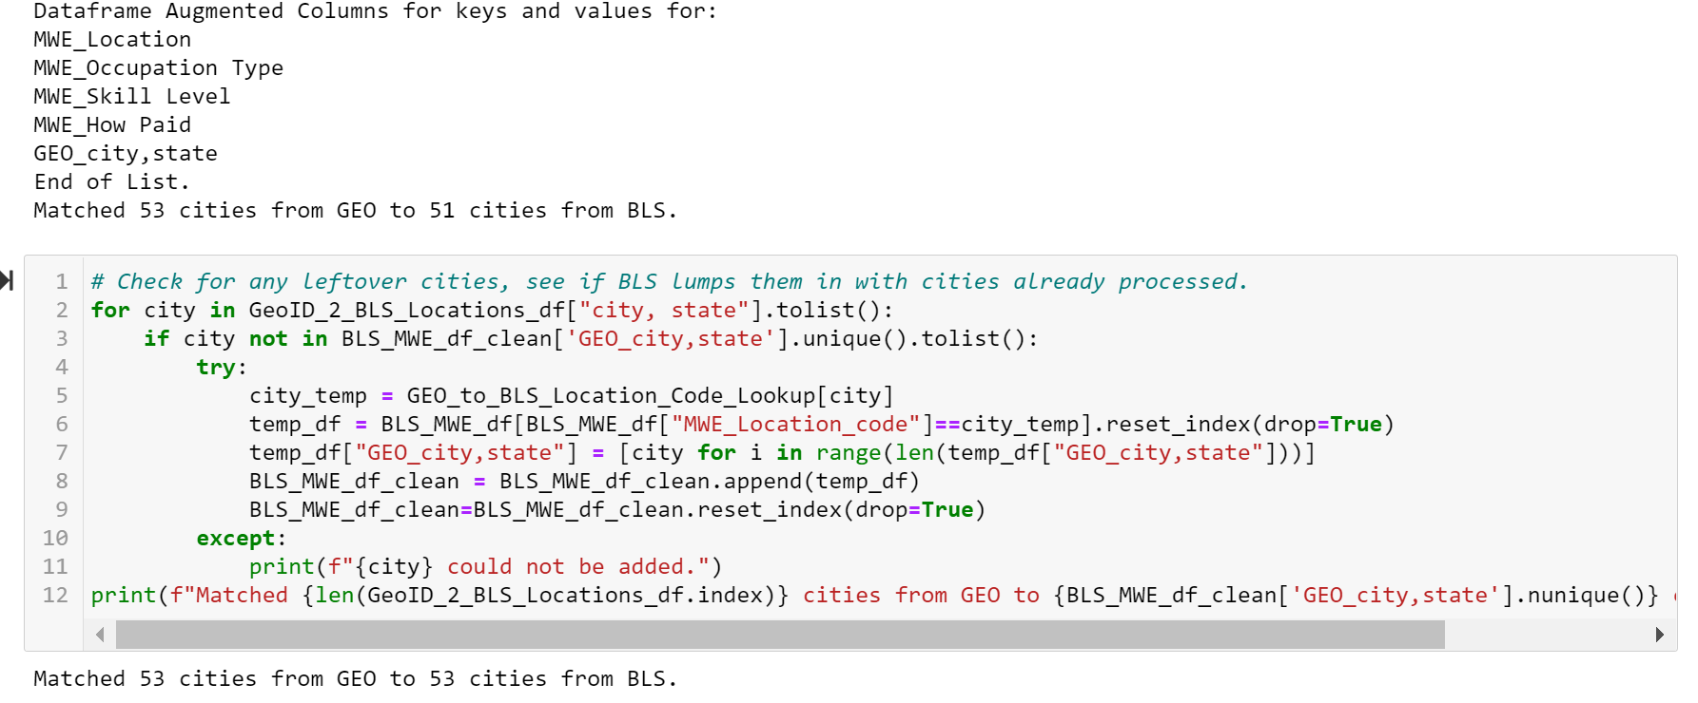
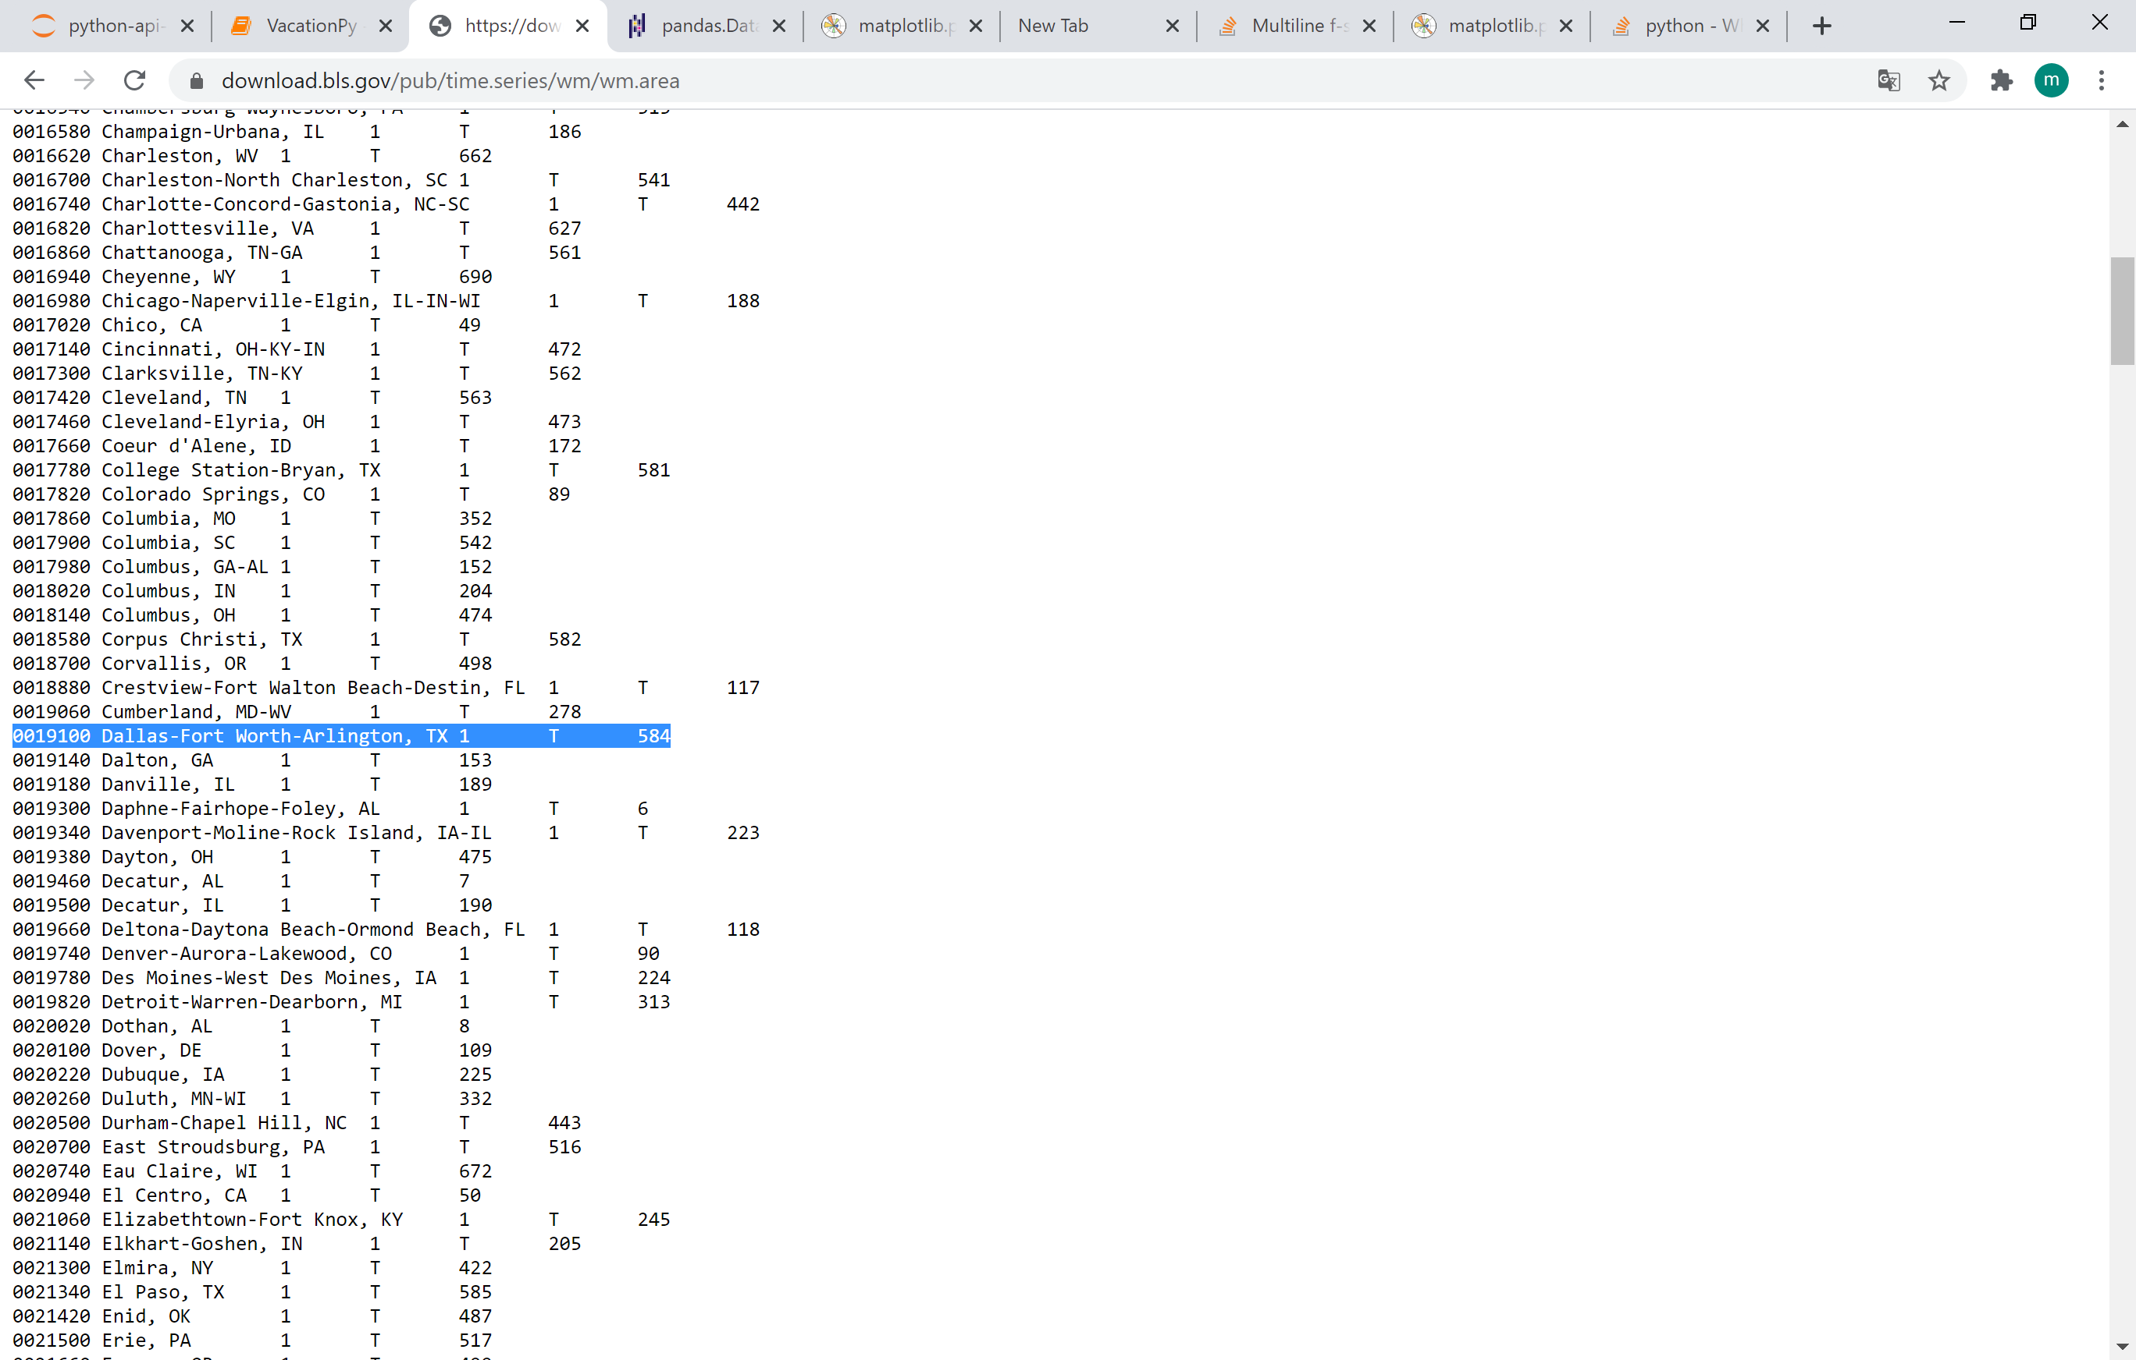
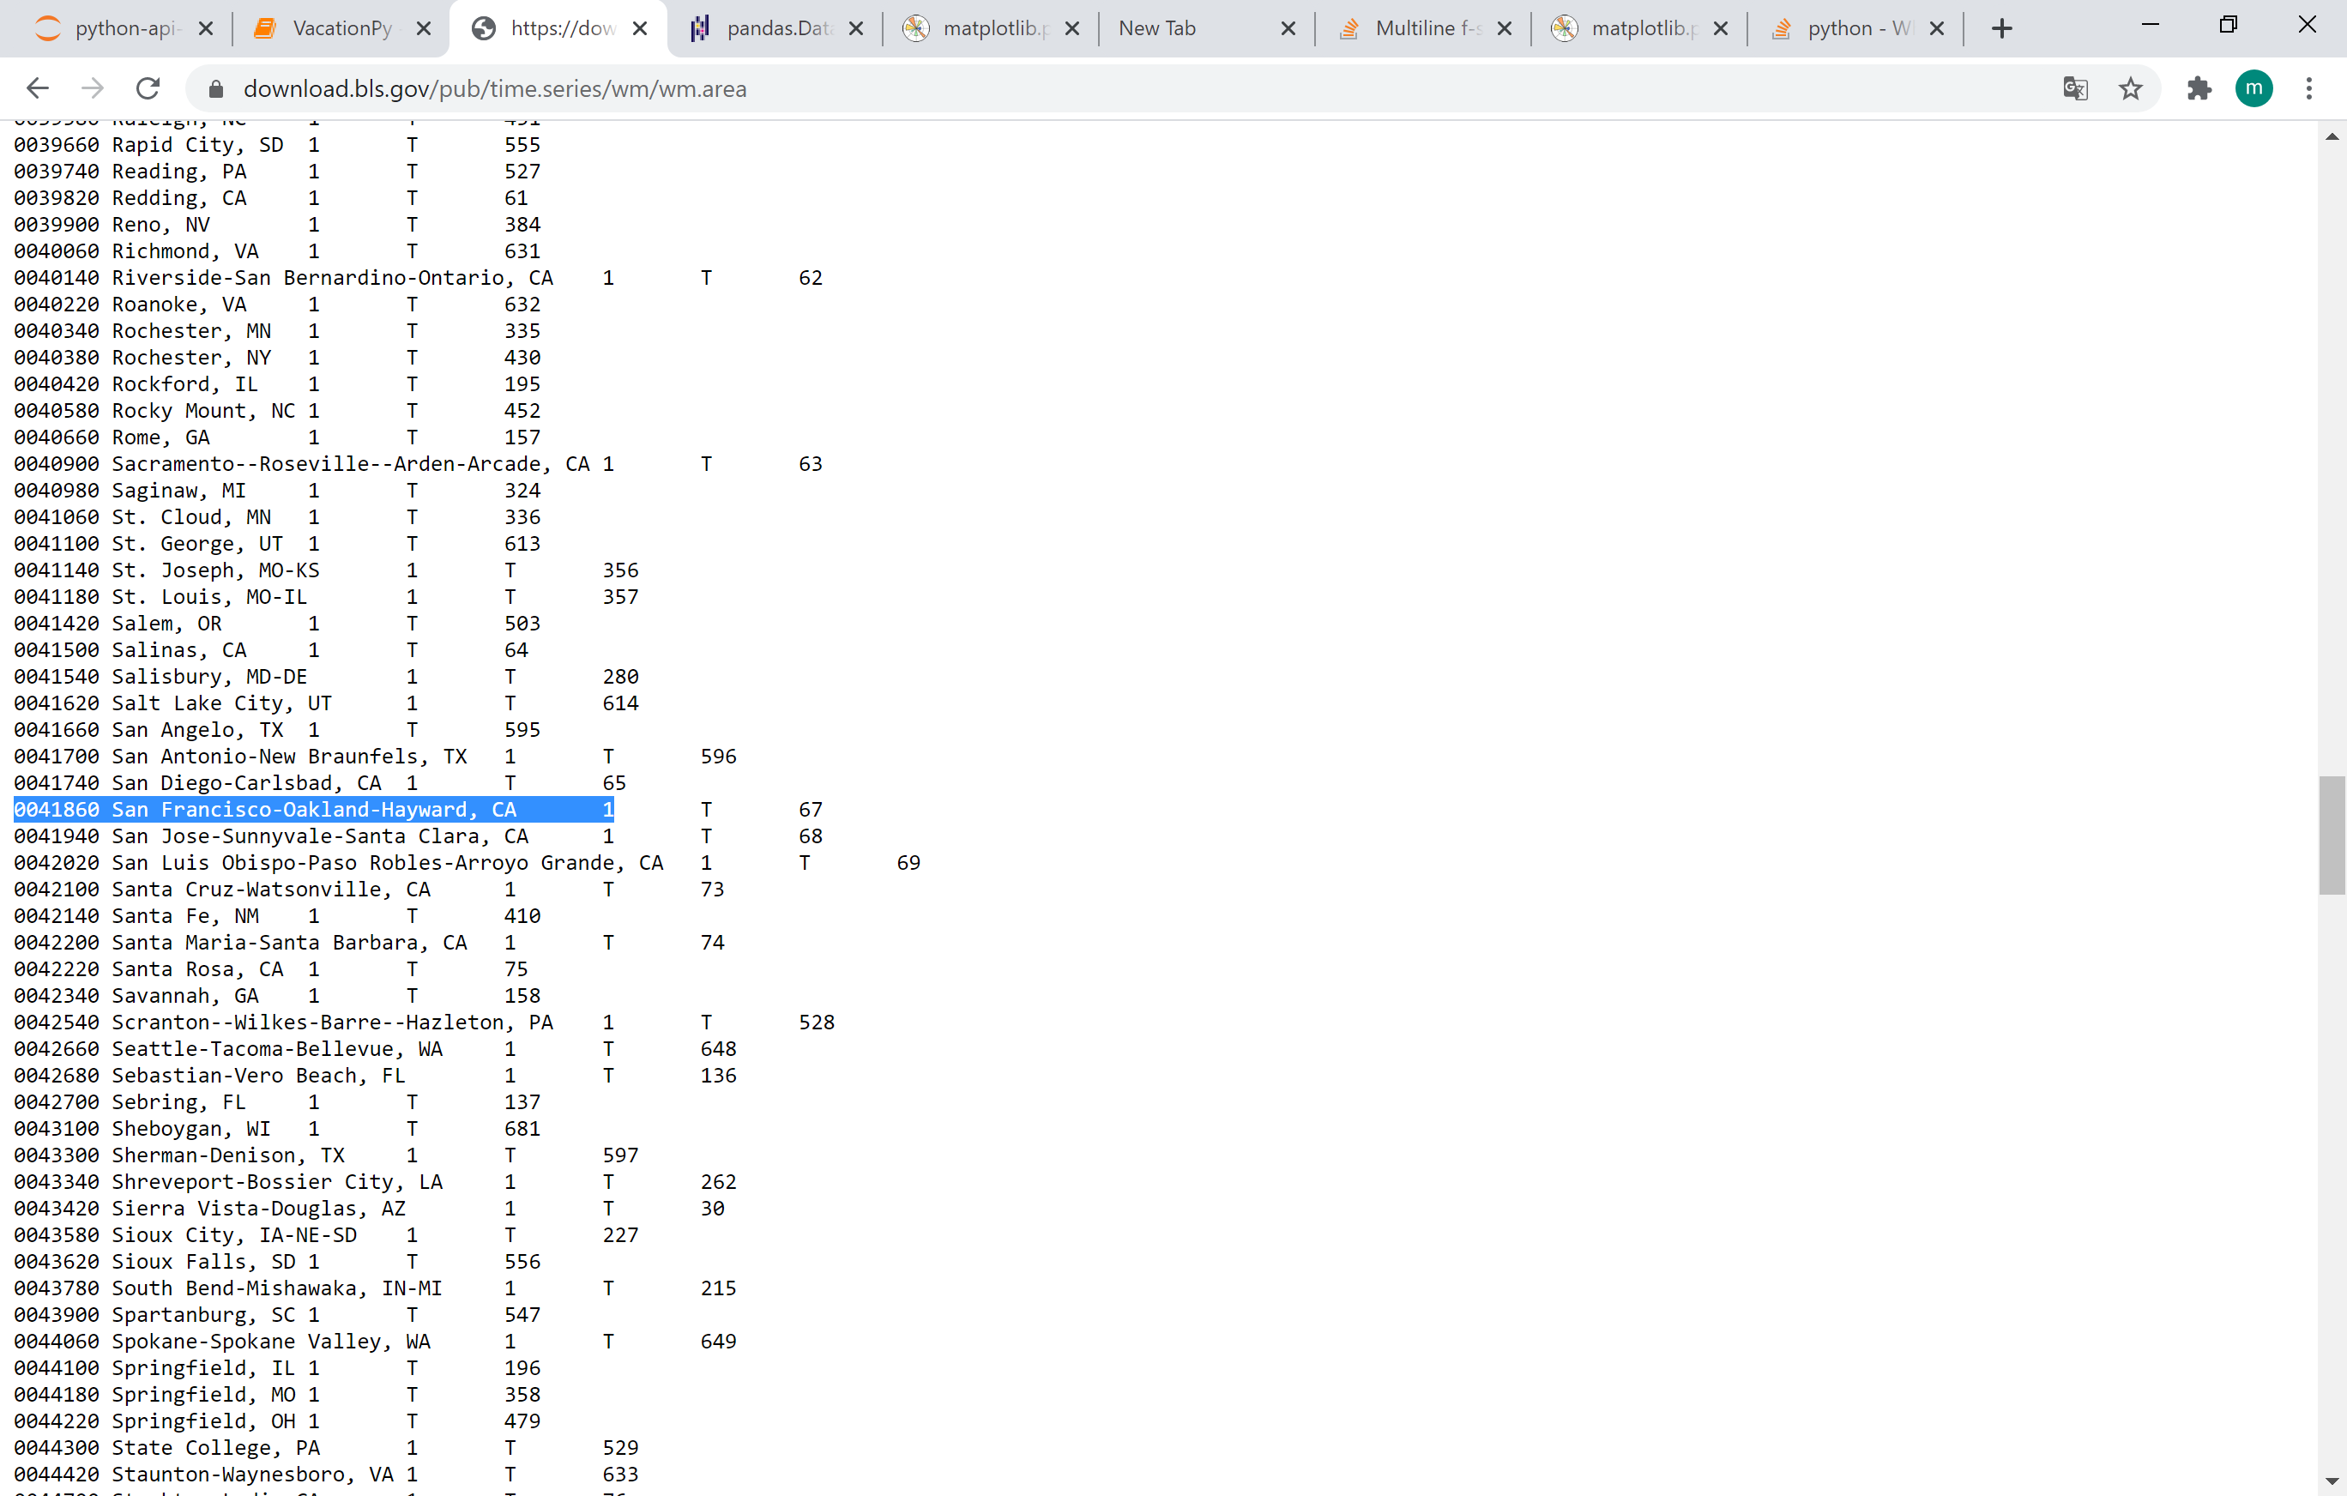
BLS MWE: Augmenting Results (City Matches)
BLS City Codes that Handle 2 Cities Each
Need to match regional dictionary values from the BLS to given cities in GEO.
A direct match means the city is listed as is, best match finds a BLS value that contains both city and state substrings. If those fail, the state was used (not actually invoked). If all else fails, city could not be added (not actually invoked).
Dallas, TX and Fort Worth, TX as well as San Francisco, CA and Oakland, CA were in single BLS group code. Since only one row was created for each pair, one city from each pair may be missing in the final merged dataframe.
The for-loop copies rows for paired city from the dataframe, modifies city name to the missing city in the copy, and then adds the rows back to the original dataframe so that the missing city is present with rows from the grouped code.

Slide 10
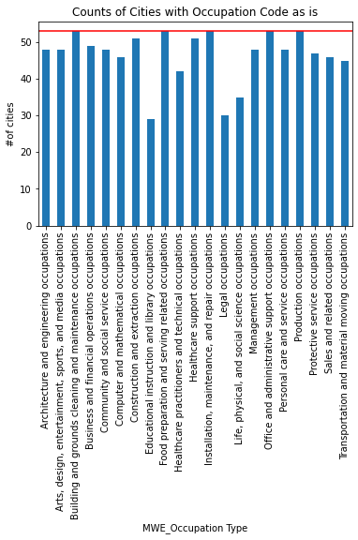
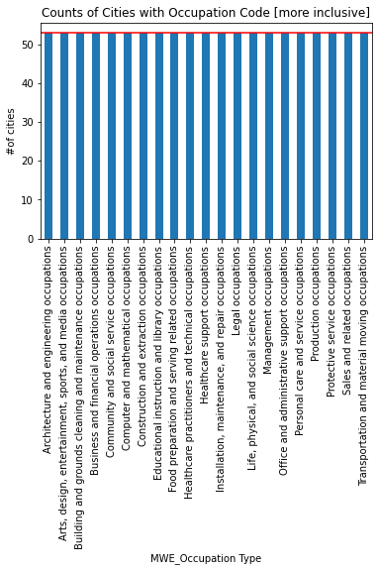
BLS MWE: Augmenting Results (Occupation)
Augmentation Process
With 53 cities from the GEO data, there should be 53 results from filtering the dataframe to a each of the 21 Occupation types.
However, some occupations have fewer results.
The occupations are given as industry (as shown) but also “how paid” set to full time and “level” set to all skill levels.
By loosening the how paid and skill level searches in a copy of the original data frame (city by city), taking the first row, and augmenting the original dataframe, the results are boosted to 53.
“how paid” and “skill level” are retained to ensure transparency of what was done.
Most results still in the desired format.

Slide 11
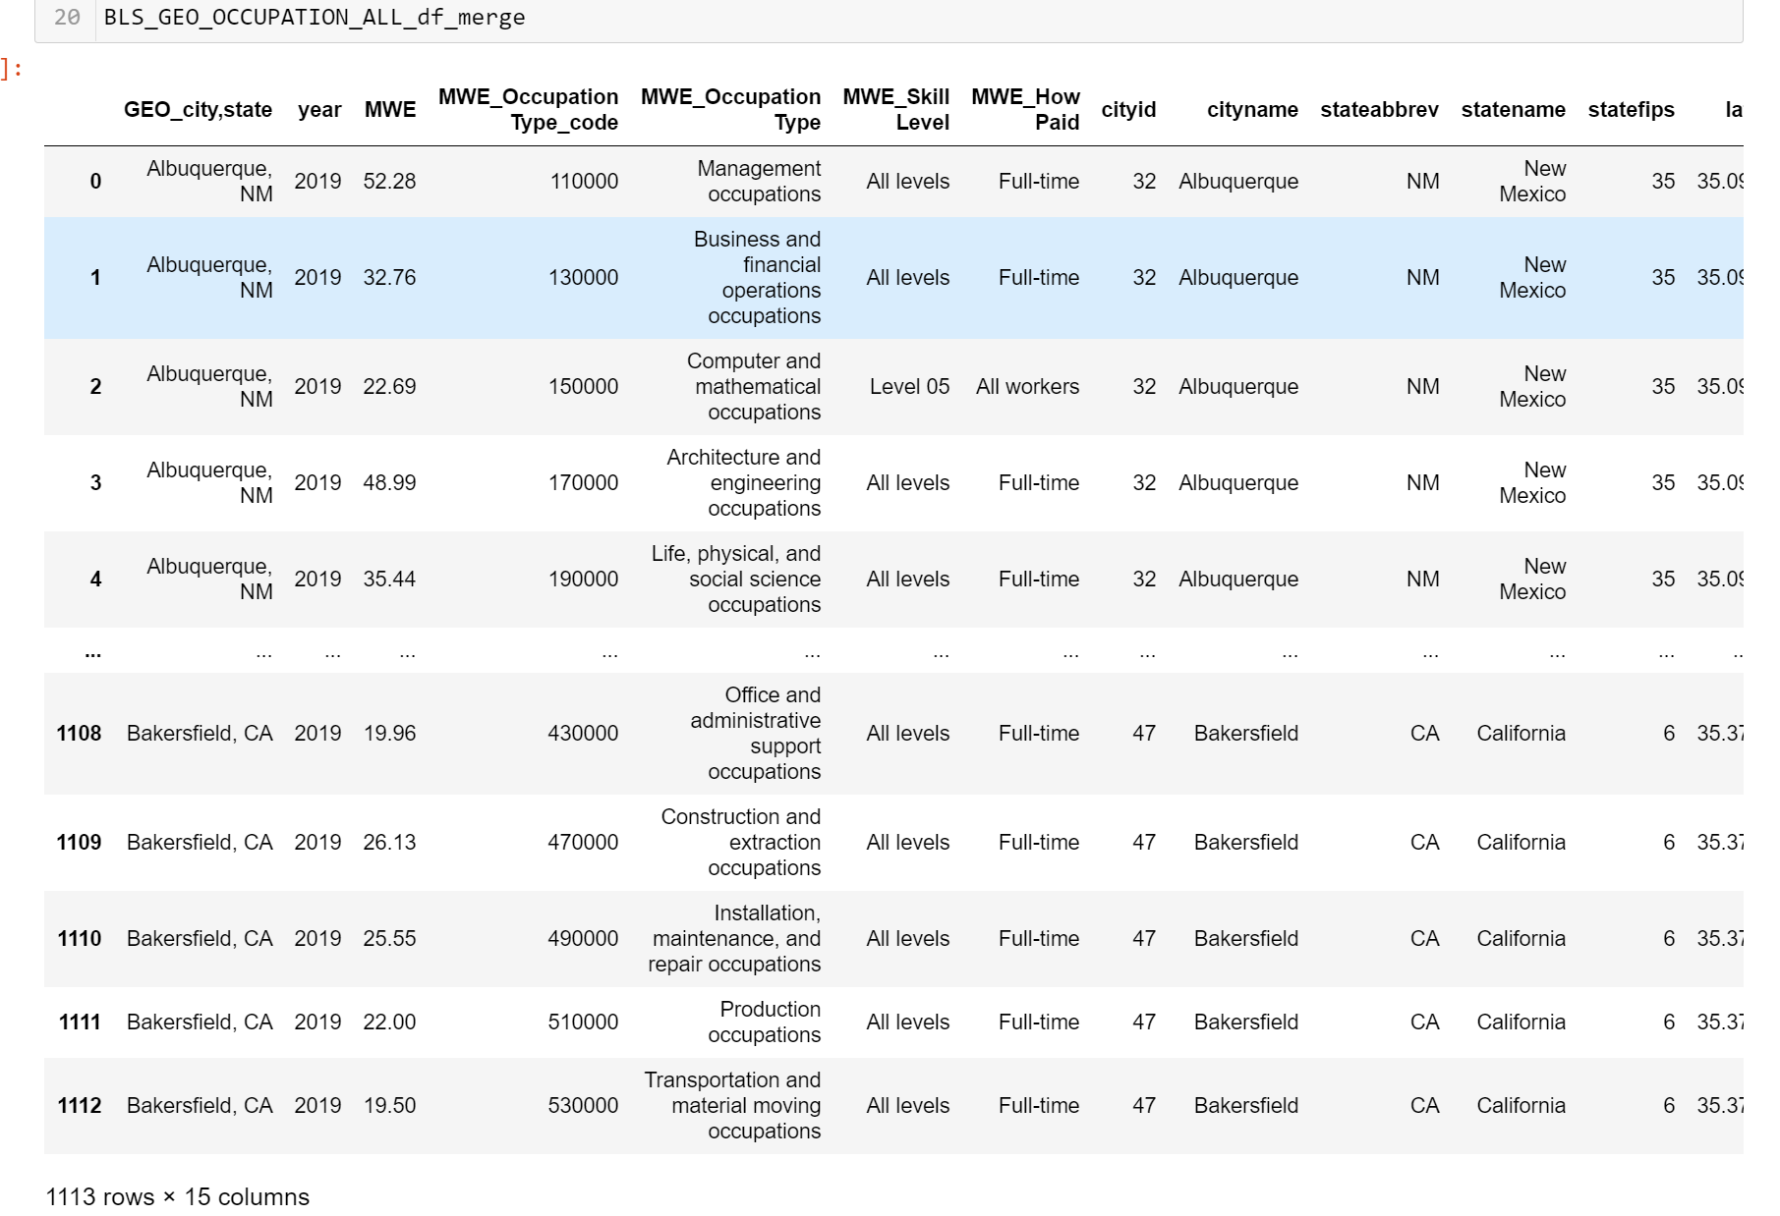
.csv Output
KEY TAKE AWAYS
Data is merged on GEO_city, state but is now able to be merged on cityid in future uses by importing the written .csv file.
One row exists for every chosen city/occupation combination.
Data displays loosened search parameters for occupation, where needed (how paid, skill level).
BLS MWE values in MWE column are provided for use or “Not Found” if data was unavailable.
Able to display expected $/hr from 2019 for any of 21 given occupations in any of 53 given cities, as defined by GEO. (GOAL!)
1,113 rows = 53 cities X 21 occupation types!

Slide 12





Questions
KYLE PAVELKA
kylepavelka1@gmail.com
RAVI PATEL
rp70960@gmail.com
MATT BROWN
matthewbrown84@gmail.com
MERI FRANCO
francomeriane@gmail.com
KEVIN SHEEKEY
ksheekey27@gmail.com
“Always dream and shoot higher than you know you can do. Don’t bother just to be better than your contemporaries or predecessors. Try to be better than yourself.” —William Faulkner

Slide 13
Support slides (only if needed)
KEY TAKE AWAYS
Aa
Bb
Cc

Slide 14
ALL SLIDES AFTER THIS ONE WILL BE DELETED

Slide 15
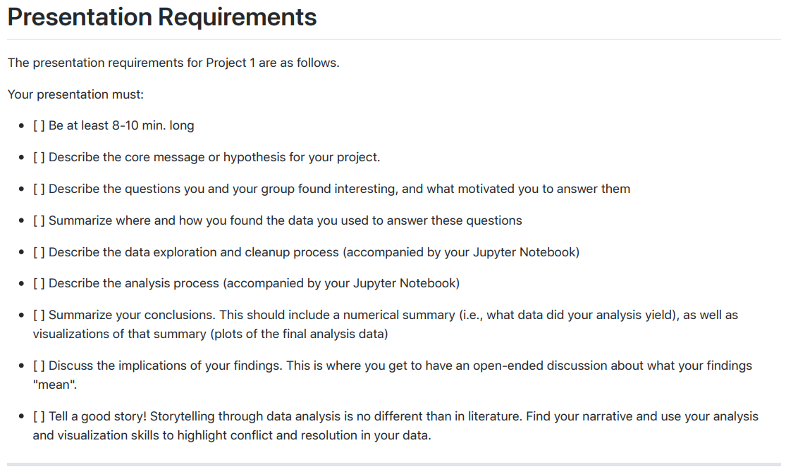

Slide 16
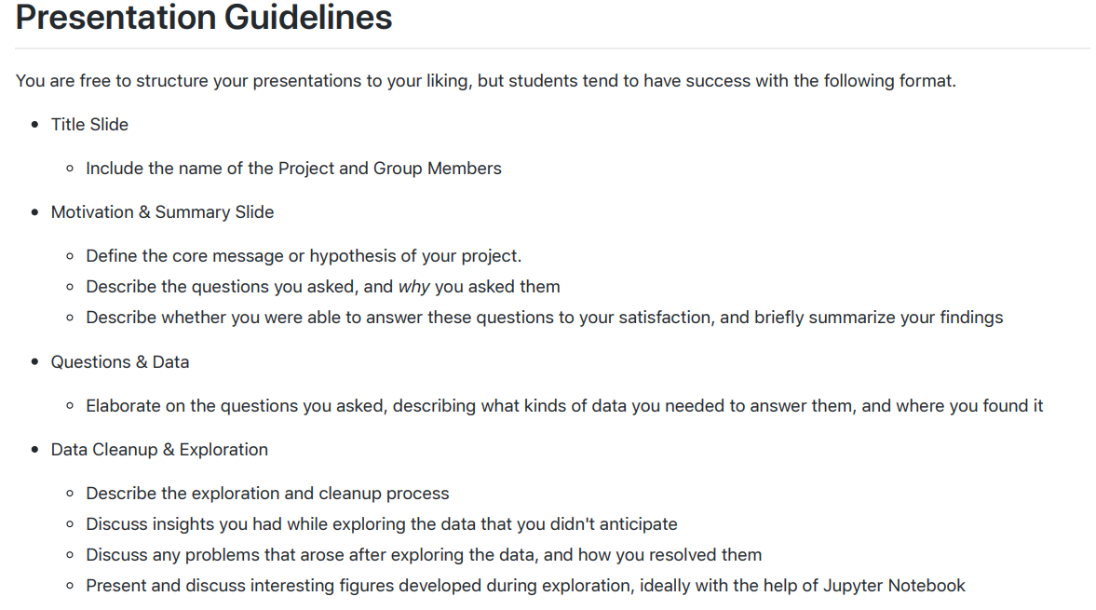

Slide 17
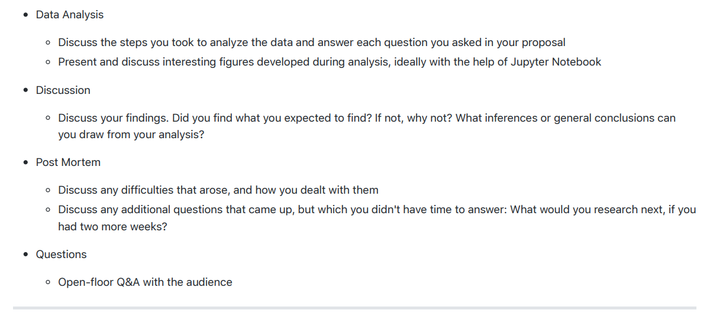

Slide 18
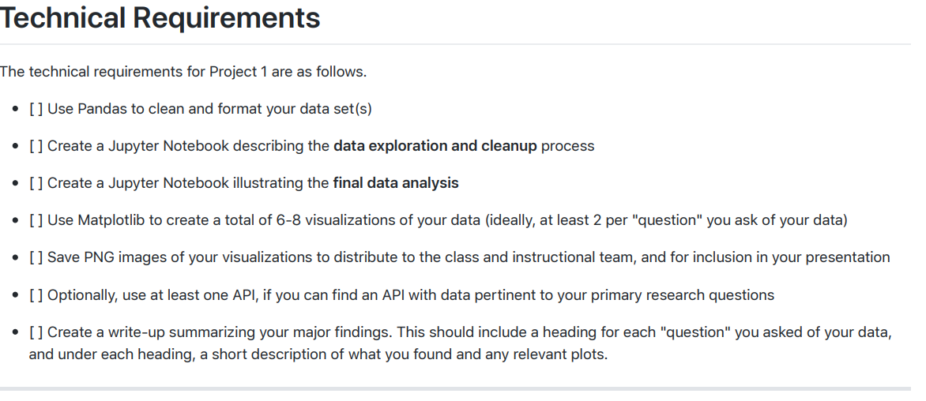

Slide 19
 | MONTHLY ANNIMATION – Business
 | Function to generate heat maps Jobs salaries

